Slide 1
Mob Programming
My first team

Slide 2
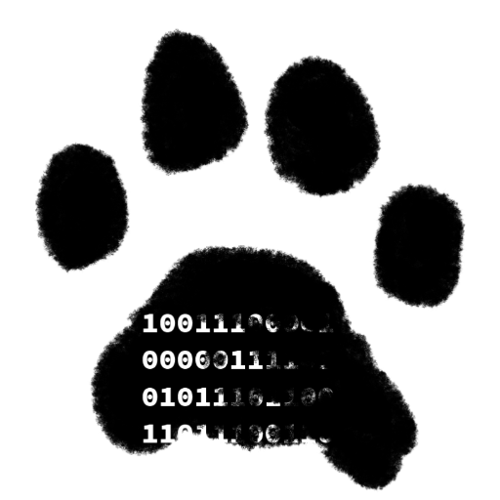

Who am I?
R. Jason Kerney
Lover of Code
Newer member
Agilist
Saving Code Wizard
Mob Programmer
Functional Programmer
(Learner)
@JasonKerney

Slide 3
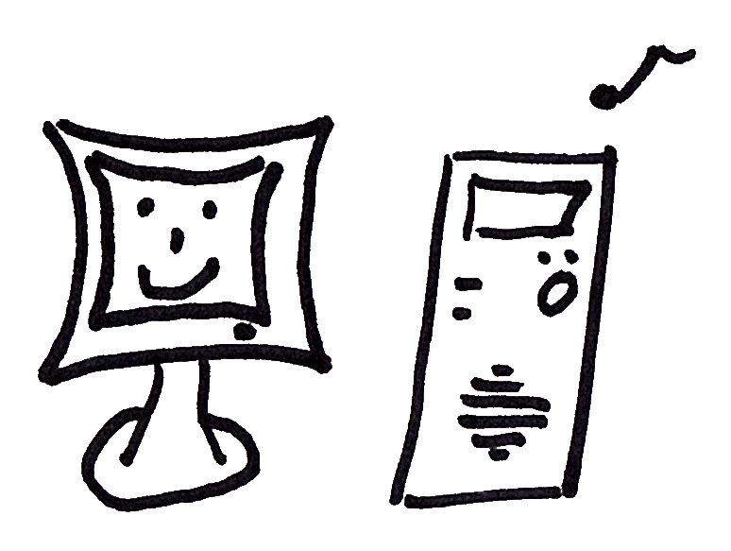
Overview
@JasonKerney

Slide 4
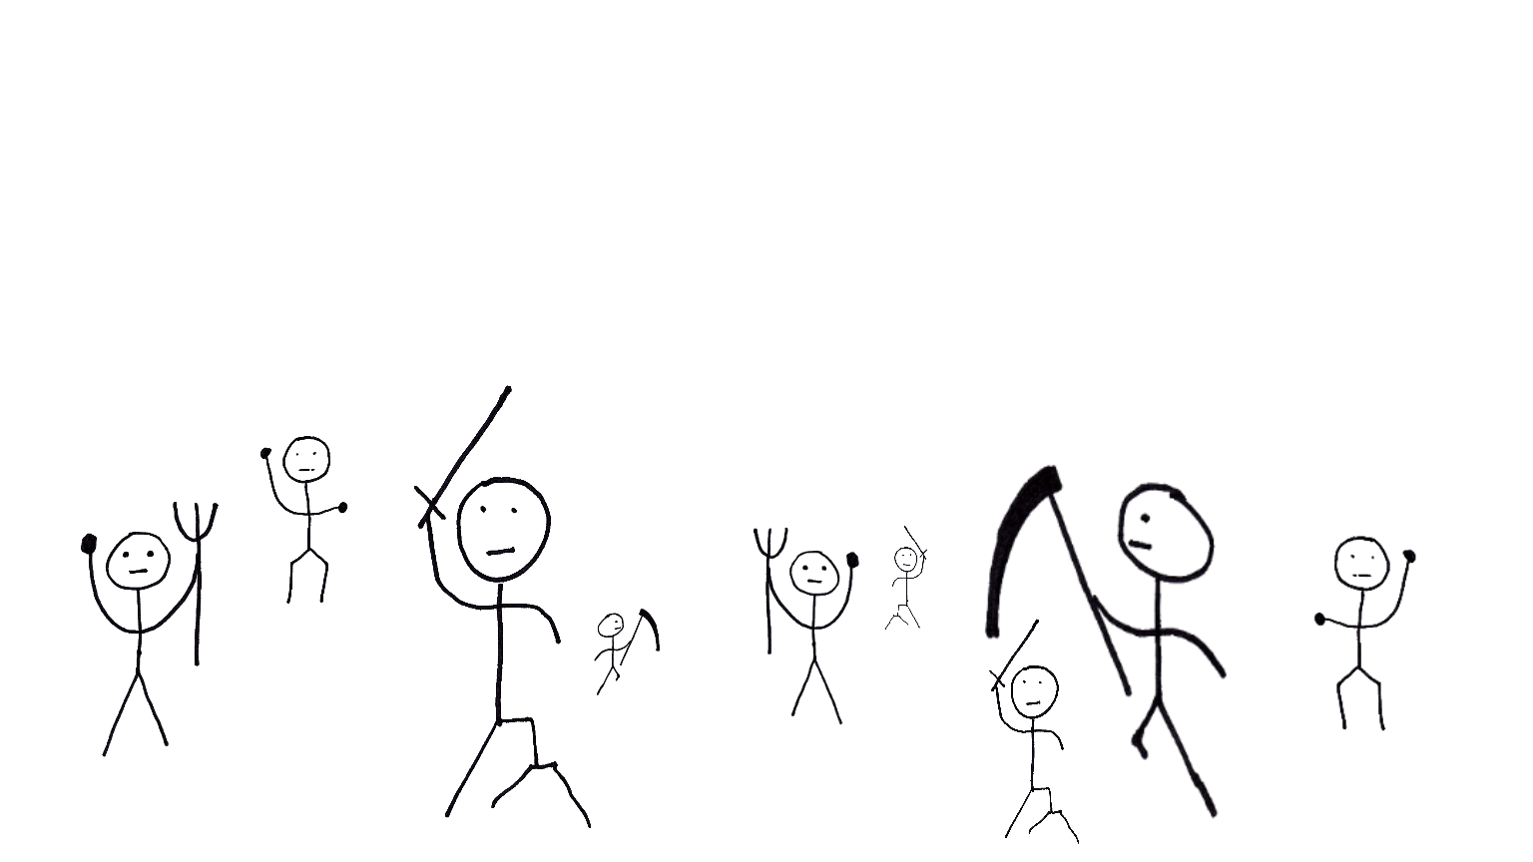
What is Mob-Programming?
@JasonKerney
All the people
working together
working
on the same thing,
on the same computer

Slide 5
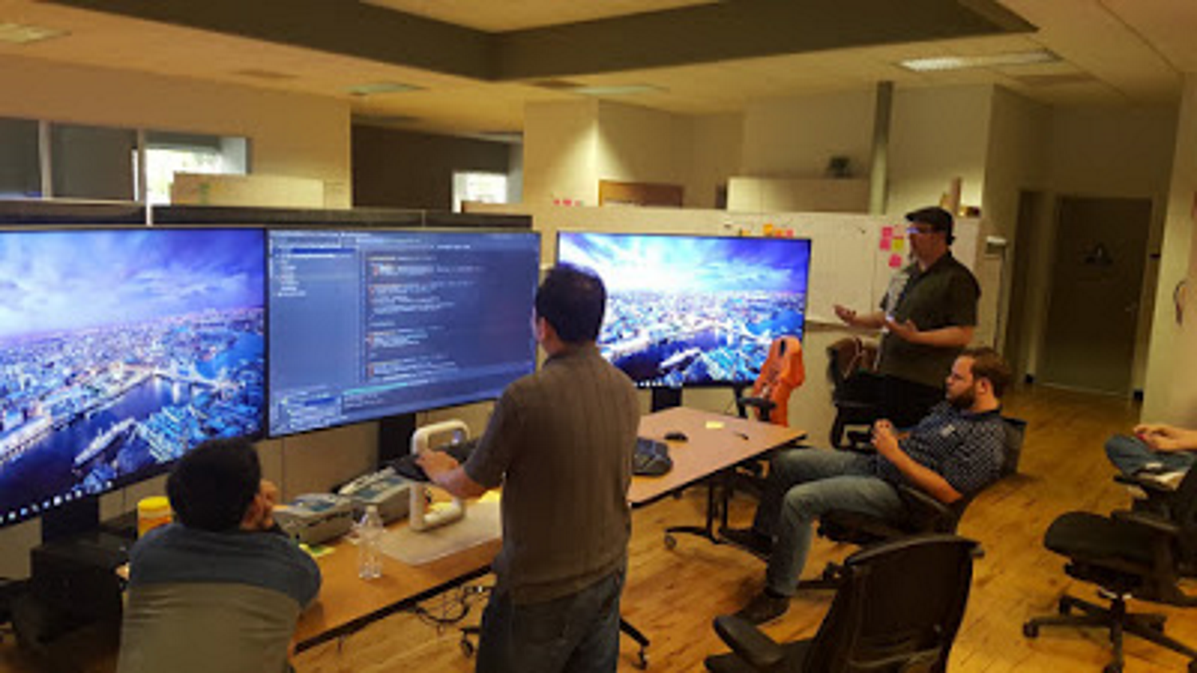

Slide 6
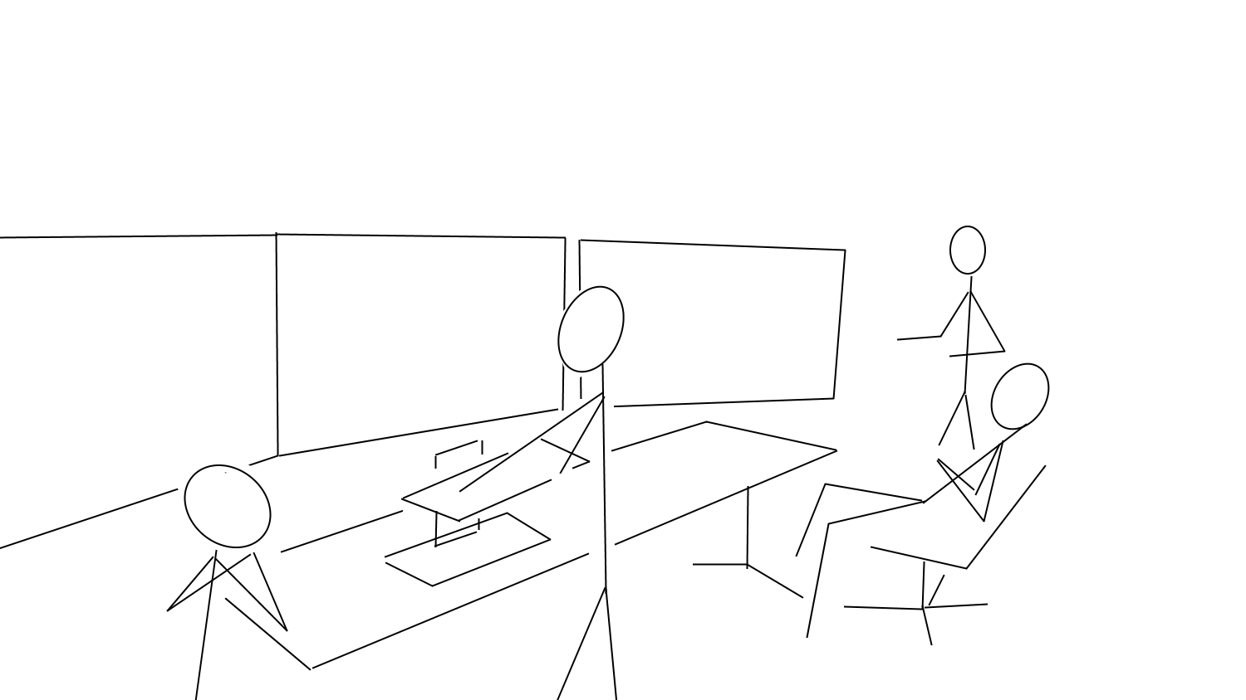

Slide 7
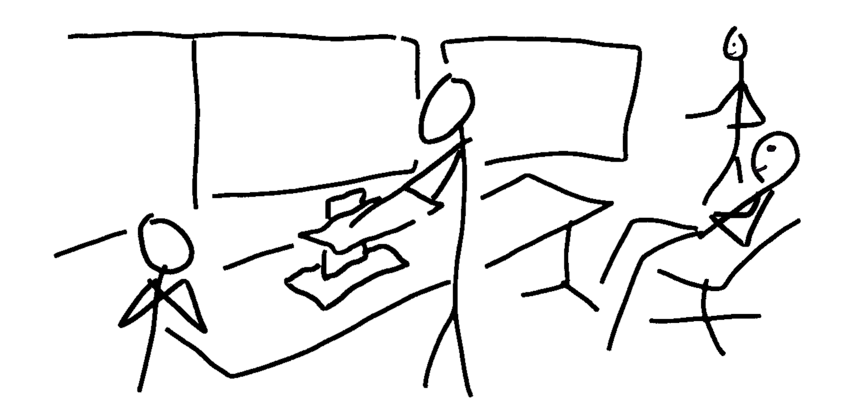

Slide 8
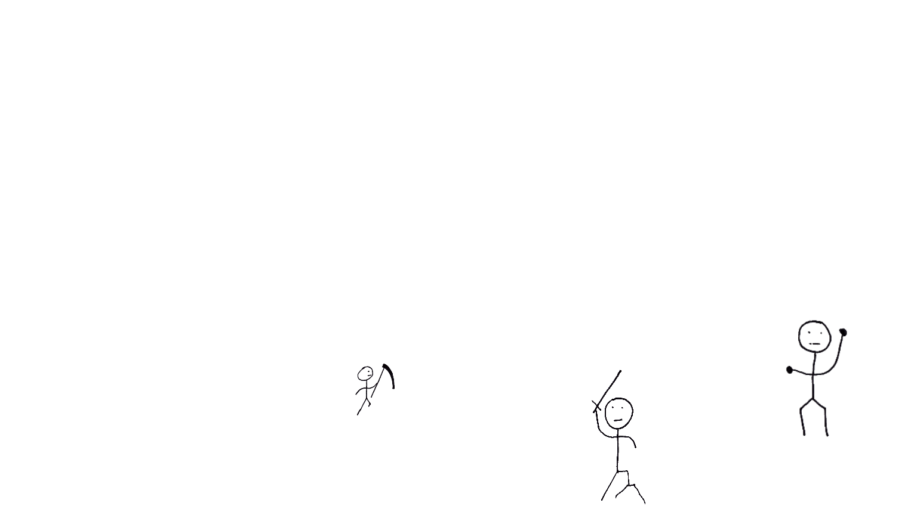
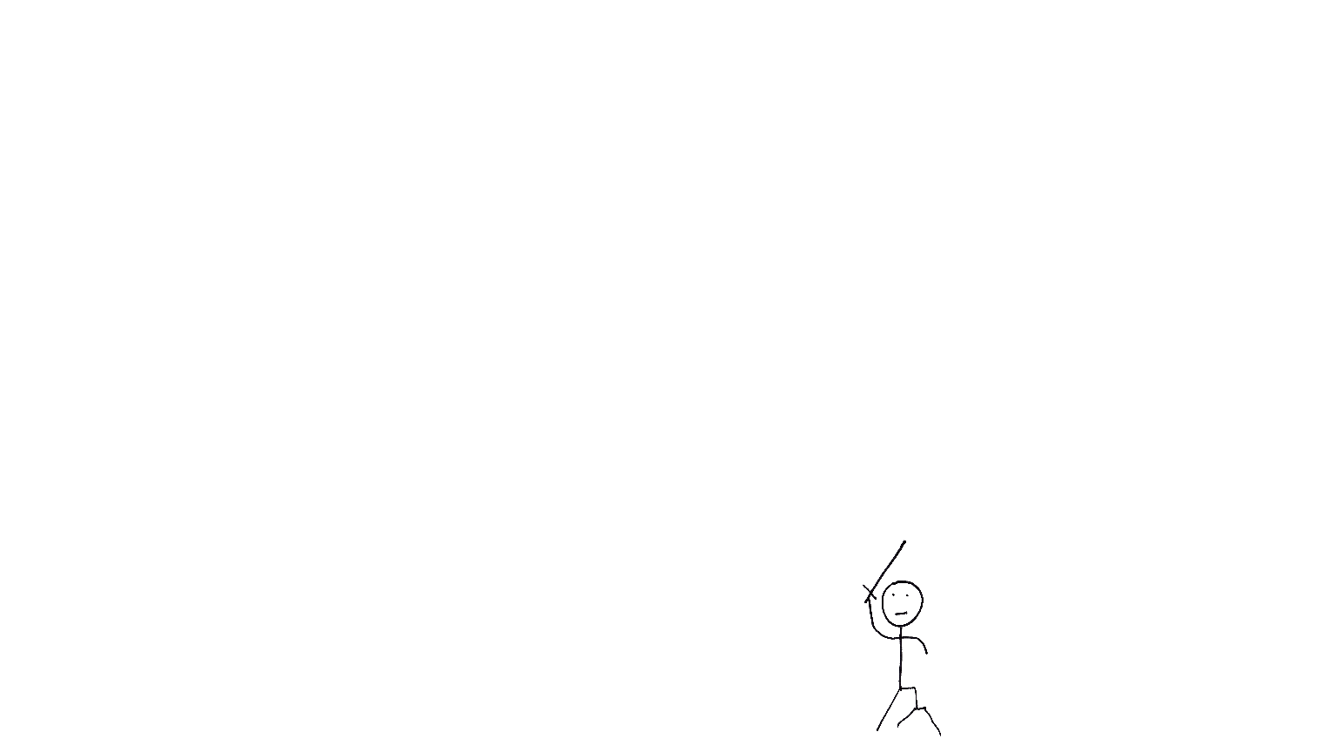
How we became a mob
@JasonKerney

Slide 9
Why we are a mob?
@JasonKerney
Because we want to be.

Slide 10

Rules
@JasonKerney
Show Kindness
Show Consideration
Show Respect
… At all Times

Slide 11
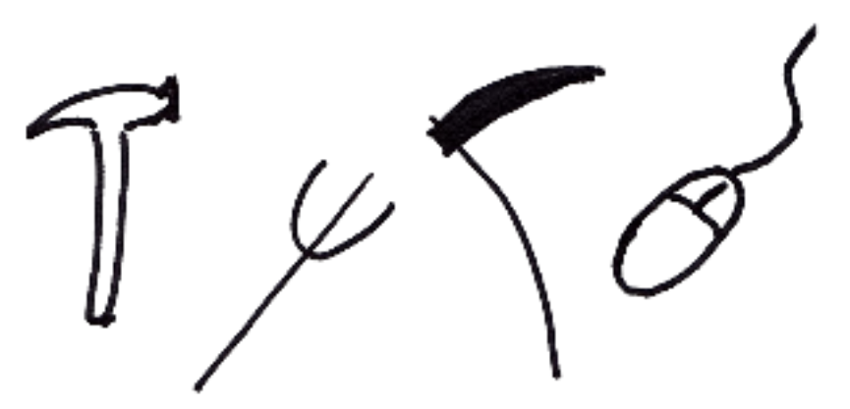
Tools
@JasonKerney
Tools

Slide 12
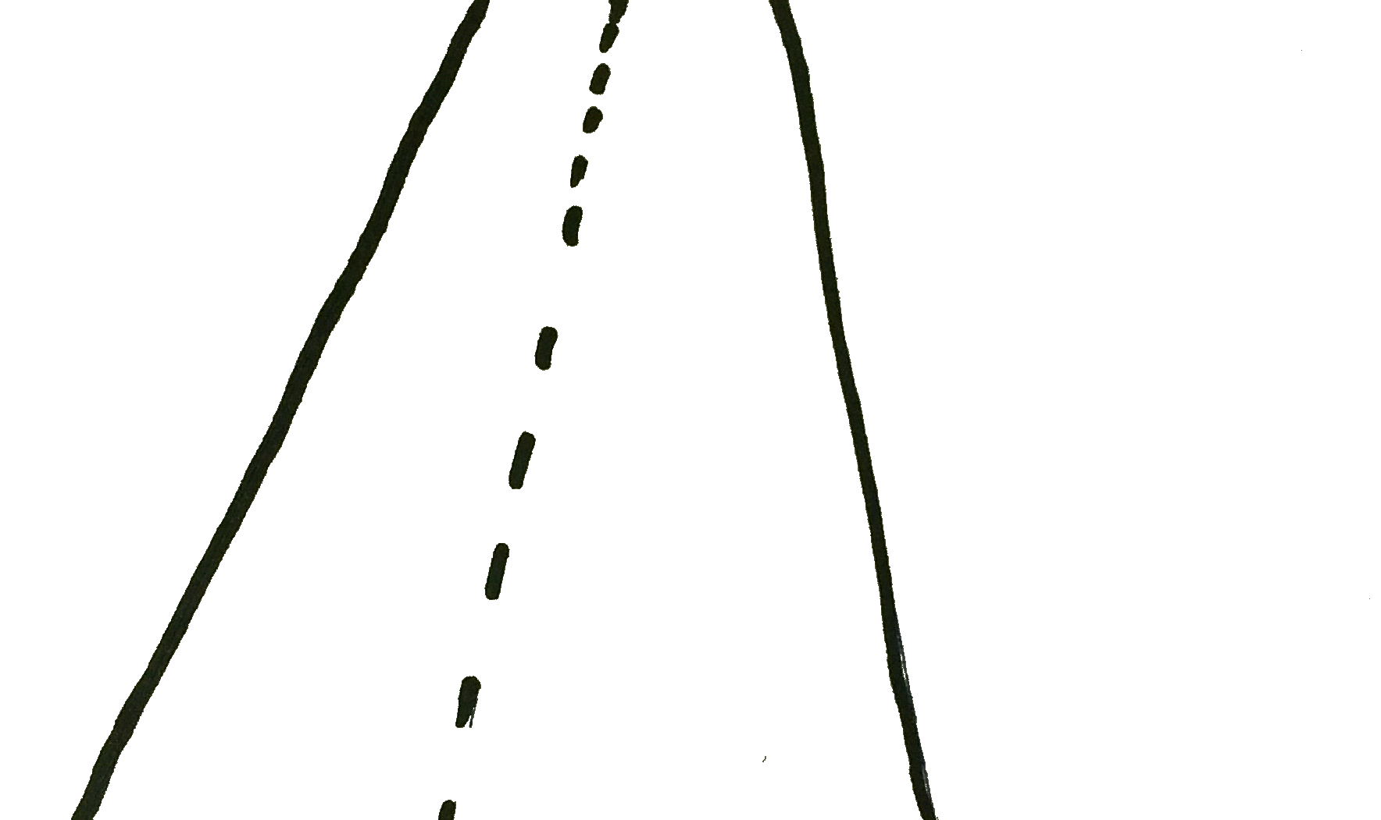
Guidelines
@JasonKerney

Slide 13
Guidelines
@JasonKerney
The Timer

Slide 14
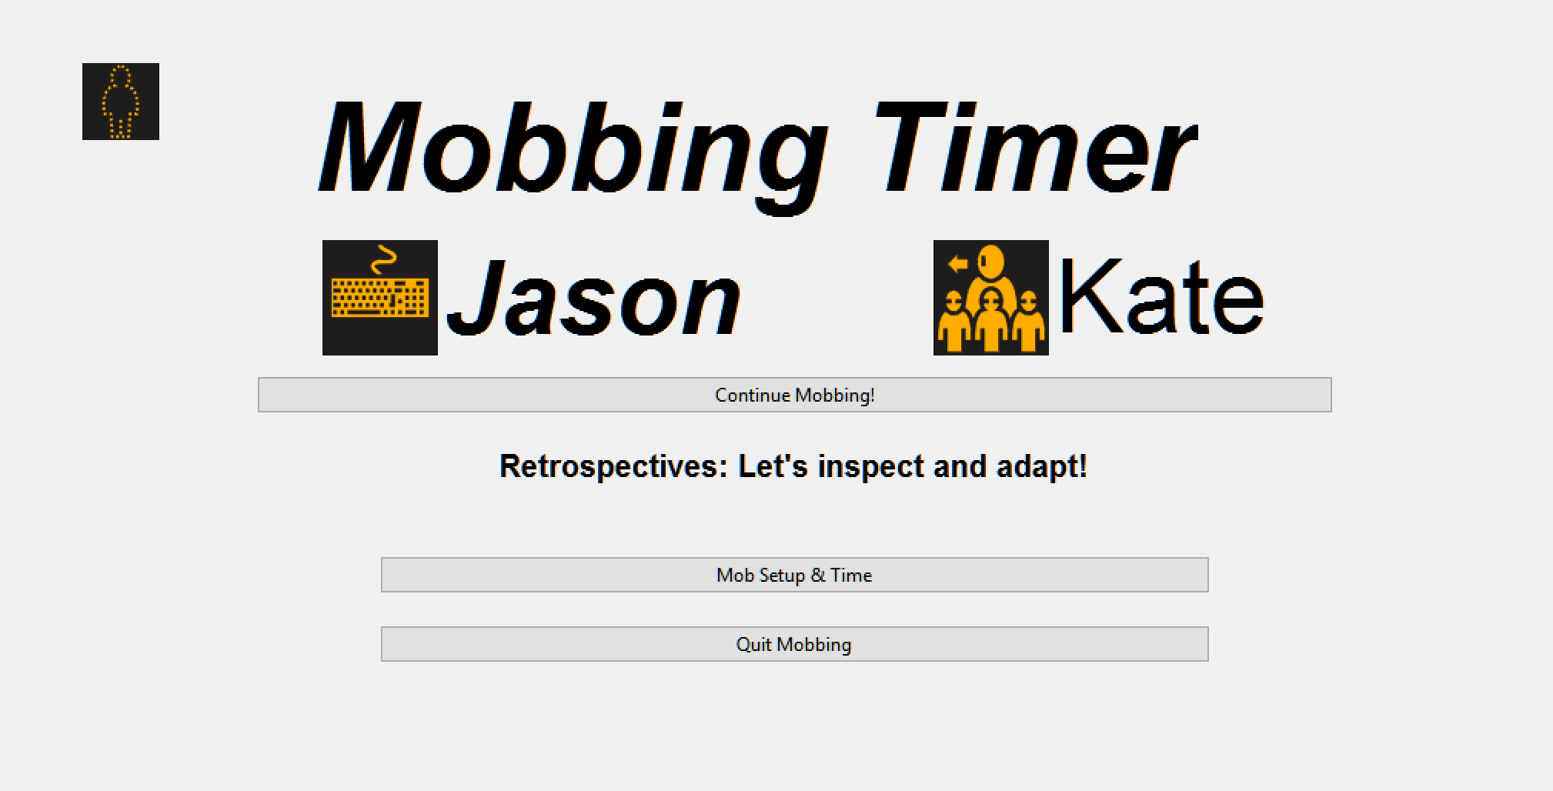
@JasonKerney
http://bit.ly/MobTimer

Slide 15
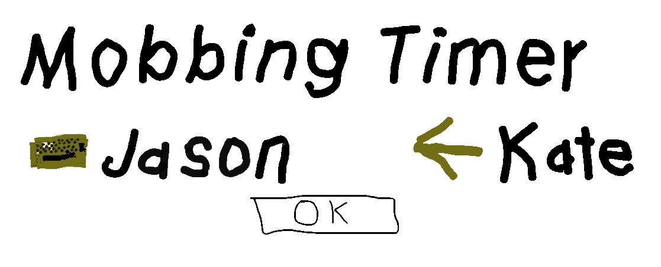
@JasonKerney

Slide 16
Guidelines
@JasonKerney
The Timer

Slide 17
Guidelines
@JasonKerney
The Timer
Driver Navigators

Slide 18
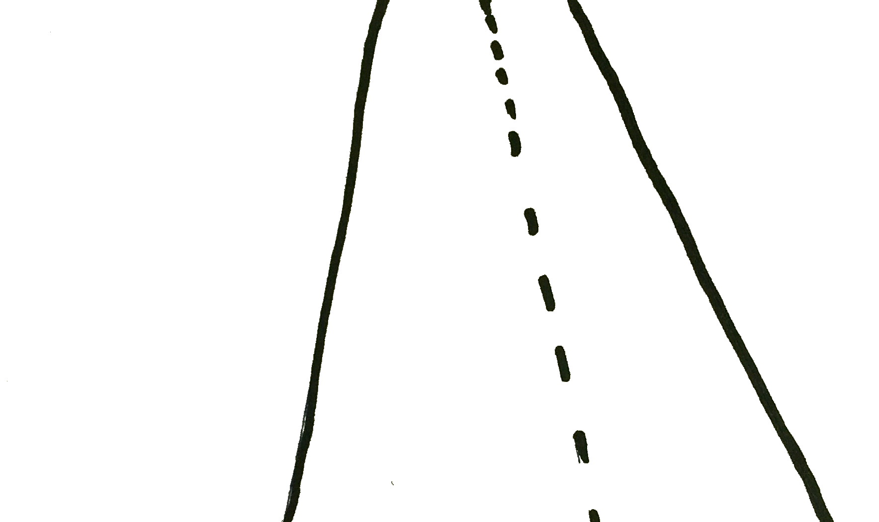
Guidelines
@JasonKerney
The Timer
Driver Navigators
Study Sessions

Slide 19
Guidelines
@JasonKerney
The Timer
Driver Navigators
Study Sessions
Automation

Slide 20
Guidelines
@JasonKerney
The Timer
Driver Navigators
Study Sessions
Automation
Guests / Visitors

Slide 21
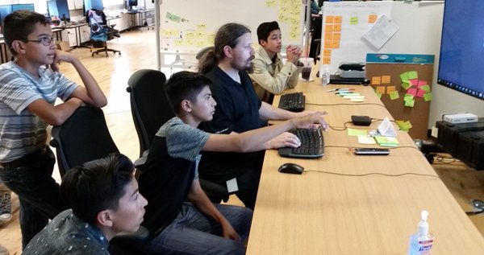

Slide 22
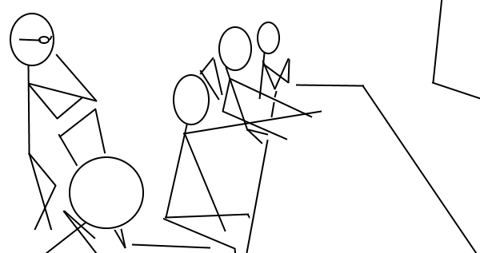

Slide 23
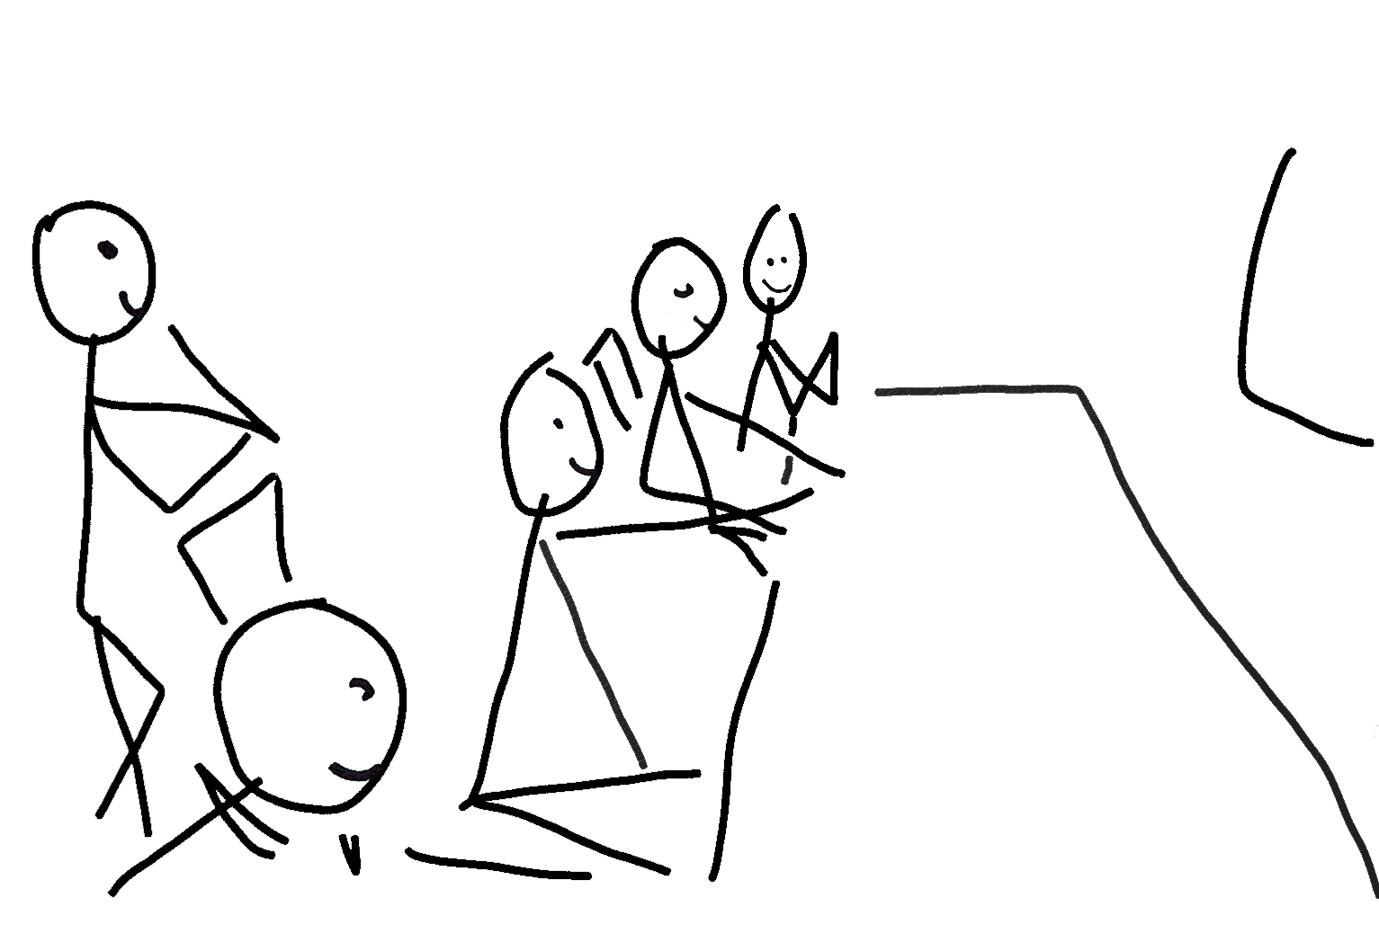

Slide 24
Guidelines
@JasonKerney
The Timer
Driver Navigators
Study Sessions
Automation
Guests / Visitors

Slide 25
Guidelines
@JasonKerney
The Timer
Driver Navigators
Study Sessions
Automation
Guests / Visitors

Slide 26
Guidelines
@JasonKerney
The Timer
Driver Navigators
Study Sessions
Automation
Guests / Visitors
Retrospect

Slide 27
Guidelines
@JasonKerney
The Timer
Driver Navigators
Study Sessions
Automation
Guests / Visitors
Retrospect

Slide 28






Learning as a team
@JasonKerney

Slide 29
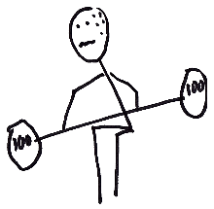
I Struggled
@JasonKerney

Slide 30
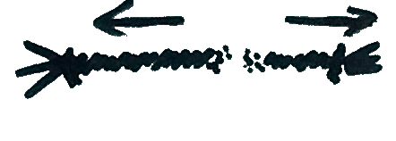
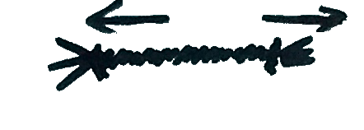
The importance of Slack
@JasonKerney

Slide 31
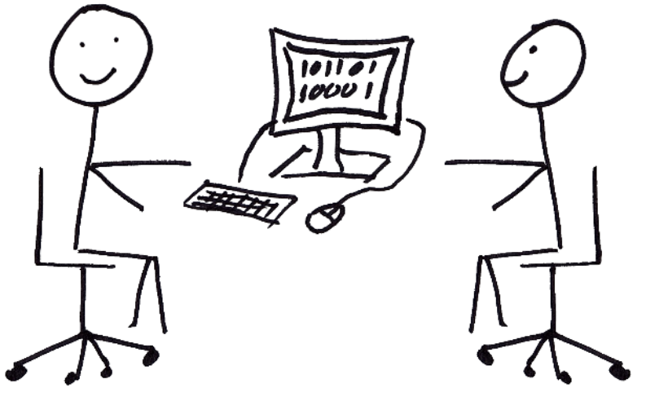
Not Advanced Pair Programming
@JasonKerney

Slide 32
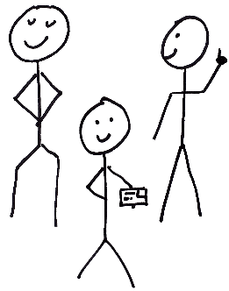
Real Teamwork
@JasonKerney

Slide 33
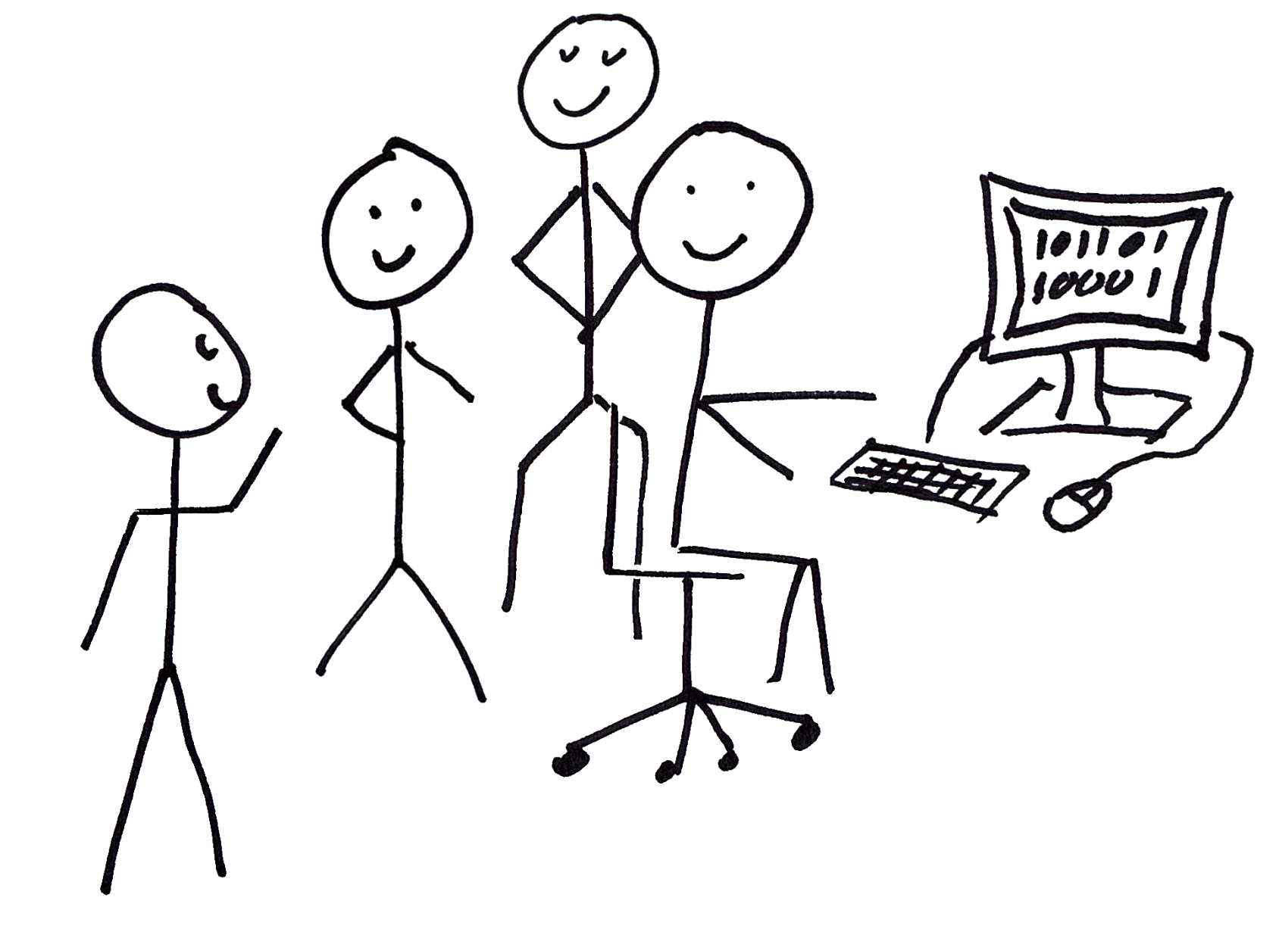
Interviewing
@JasonKerney

Slide 34
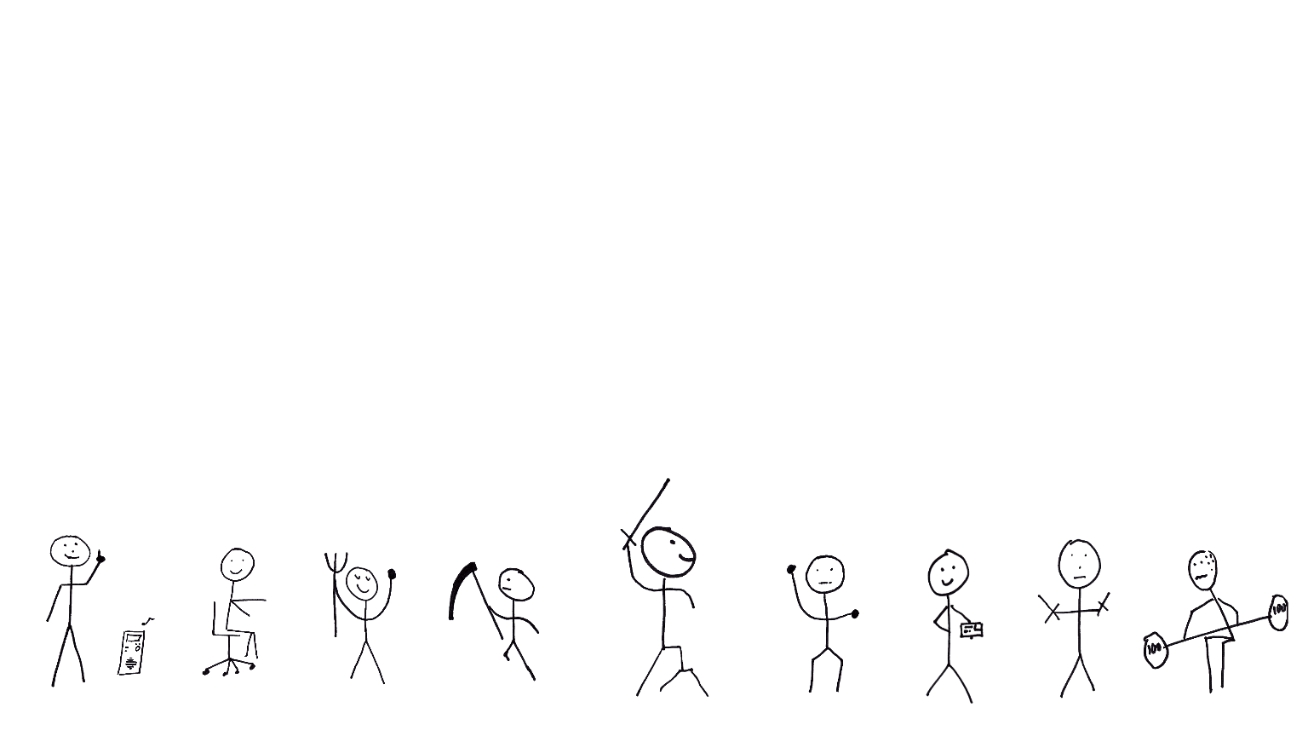
The Perfect Mob…
@JasonKerney

Slide 35
A Personal Note
@JasonKerney

Slide 36


Thank you Hunter

Slide 37
How to Find me
@JasonKerney
Twitter: @JasonKerney
Email: Jason+Mob@teamkerney.com
Blog: bit.ly/rjkBlog
Git Hub: bit.ly/rjkGitHub
Linked In: bit.ly/rjkIn
The Paper:
bit.ly/rjkFirstTeam

